Slide 1


Investigating the Evolution of Fisher Information for Neural Network Dynamics
Marc Sauter

Slide 2

Previous Talk
Collective Variables for Neural Networks
Konstantin Nikolaou

Slide 3
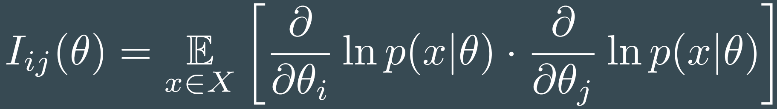
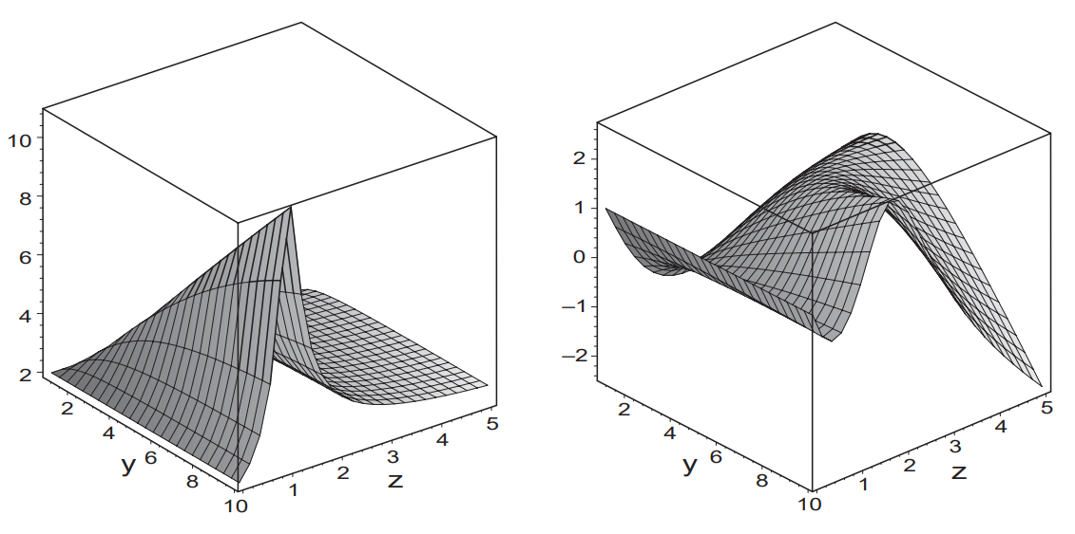
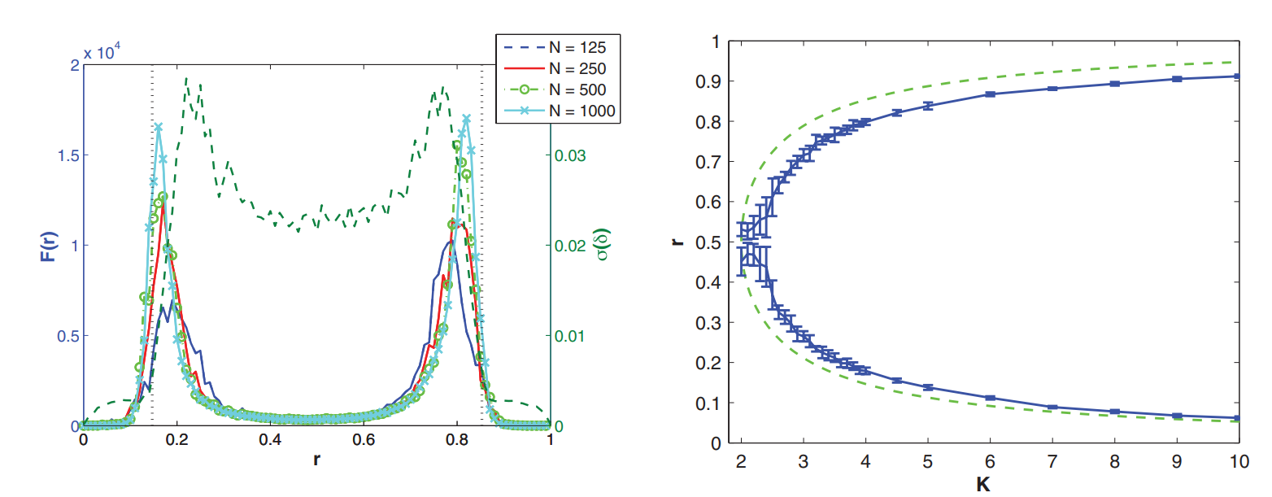
Fisher Information
Information Geometry and phase transitions
Janke et al. (2004)
Relating Fisher Information to order parameters
Prokopenko et al. (2011)

Slide 4
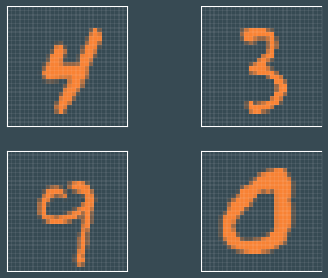
Fisher Information for Neural Networks
Dataset

Slide 5
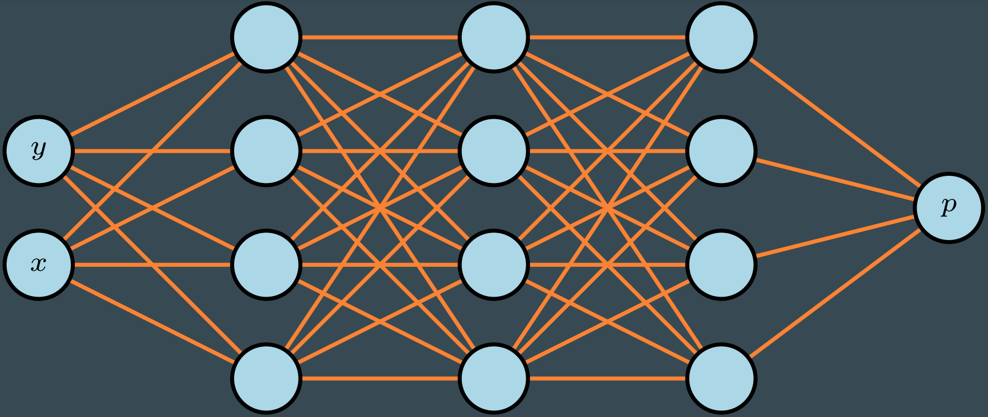
Fisher Information for Neural Networks
Dataset
Network

Slide 6
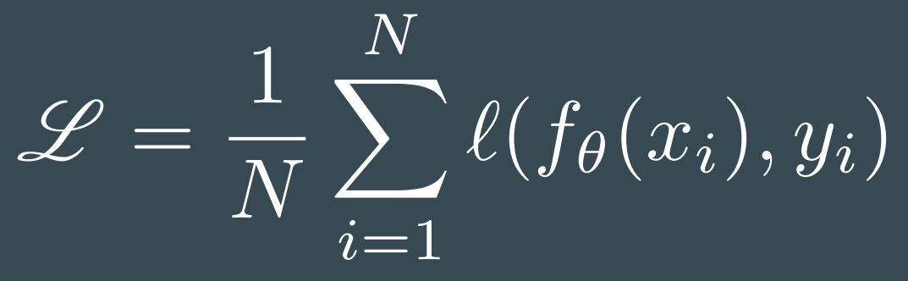
Fisher Information for Neural Networks
Dataset
Network
Introduce Loss function

Slide 7
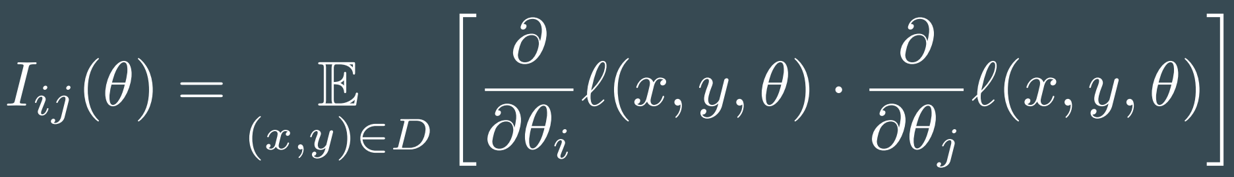
Fisher Information for Neural Networks

Slide 8
Fisher Information for Neural Networks
Established concept
Has been utilized in Natural Gradient Descent algorithm

Slide 9
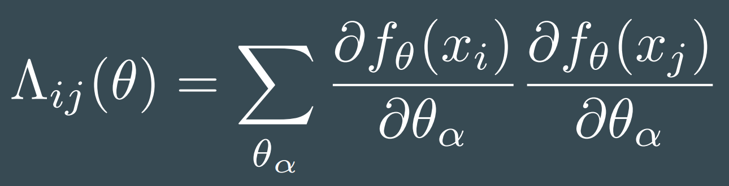
Analyzing the loss influence
Related Network dependent matrix
Full Fisher Information

Slide 10
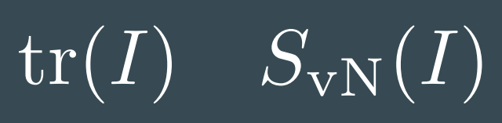
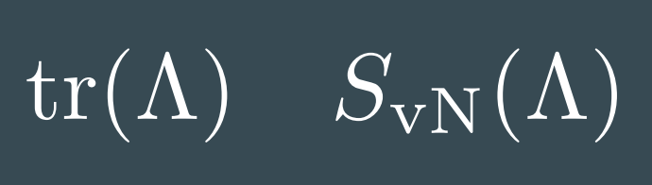
Analyzing the loss influence
Related Network dependent matrix
Full Fisher Information

Slide 11
Experimental use

Slide 12
Experimental use

Slide 13
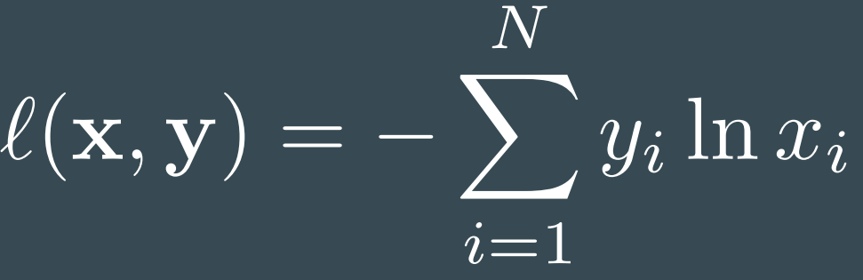
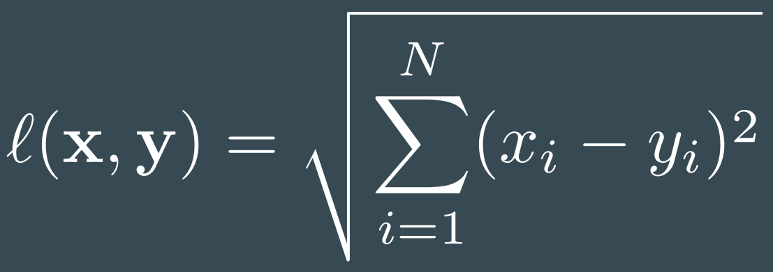
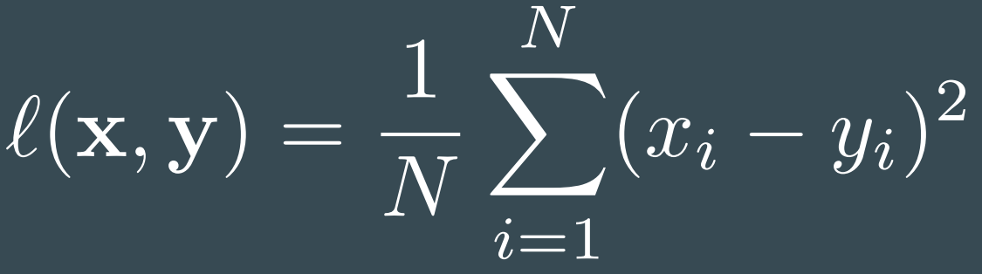
Experimental use
Cross Entropy | Lp norm of order 2 | Mean Squared Error

Slide 14
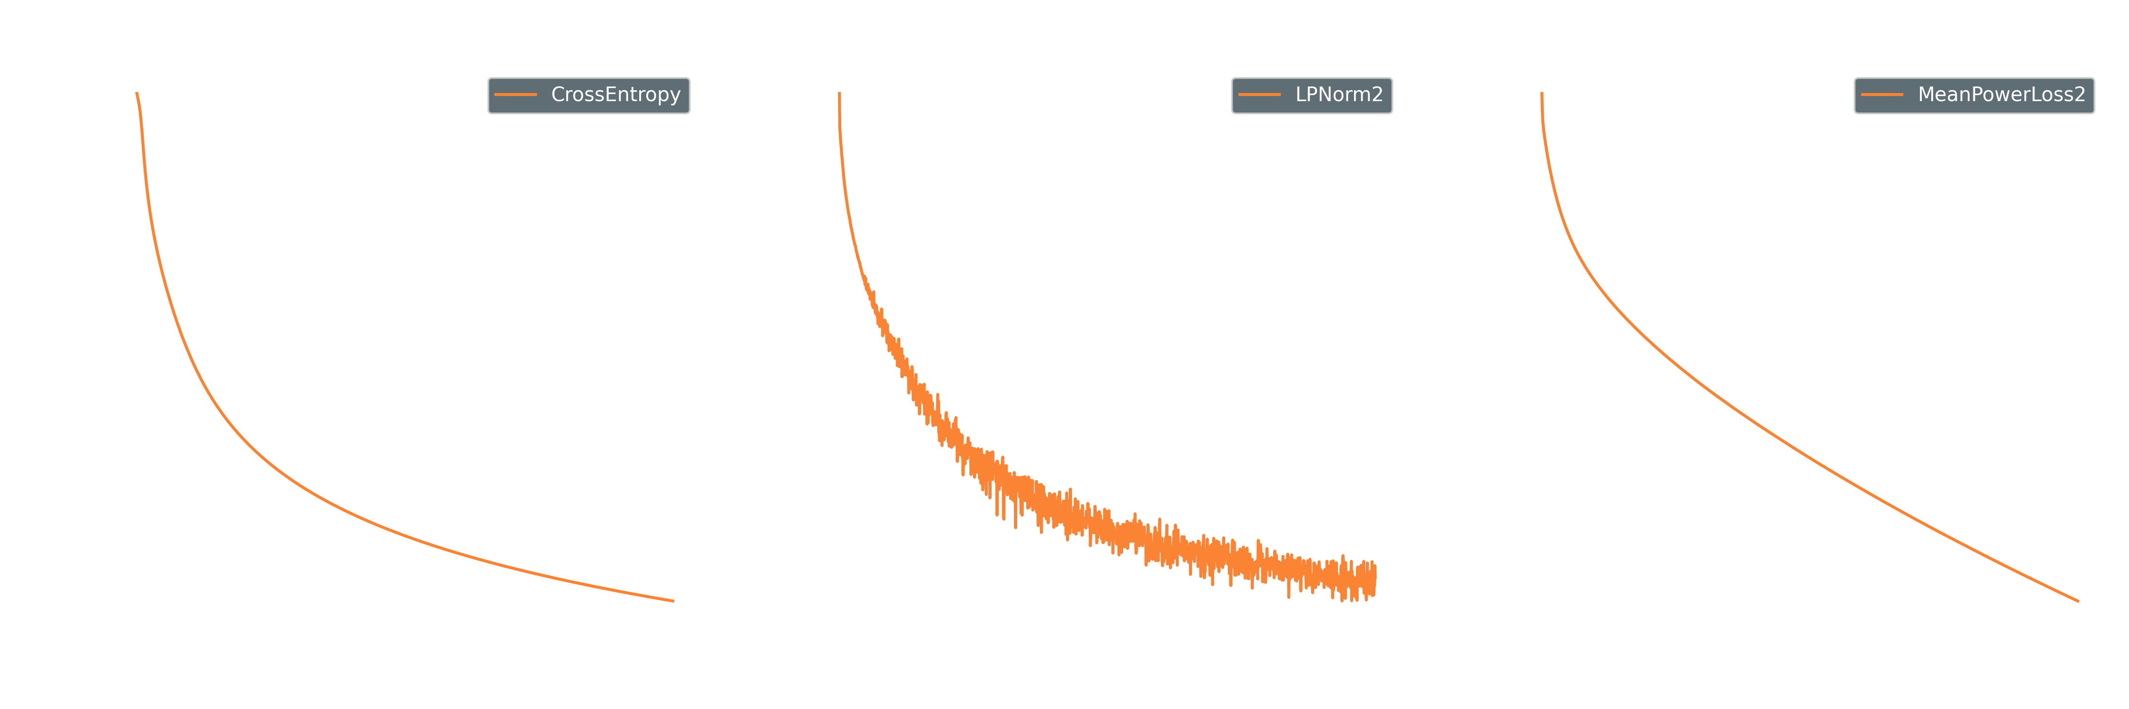
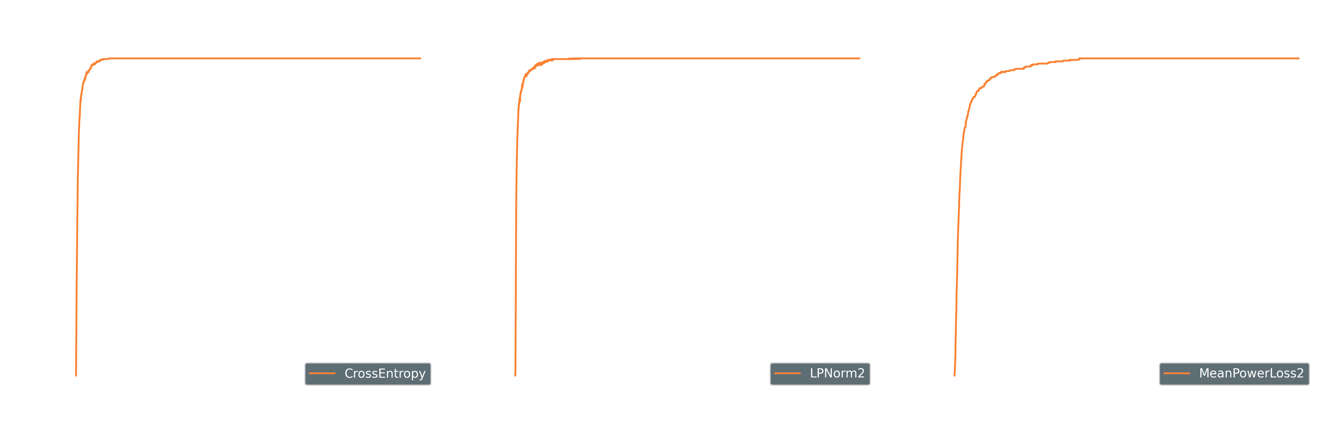
Experimental use

Slide 15
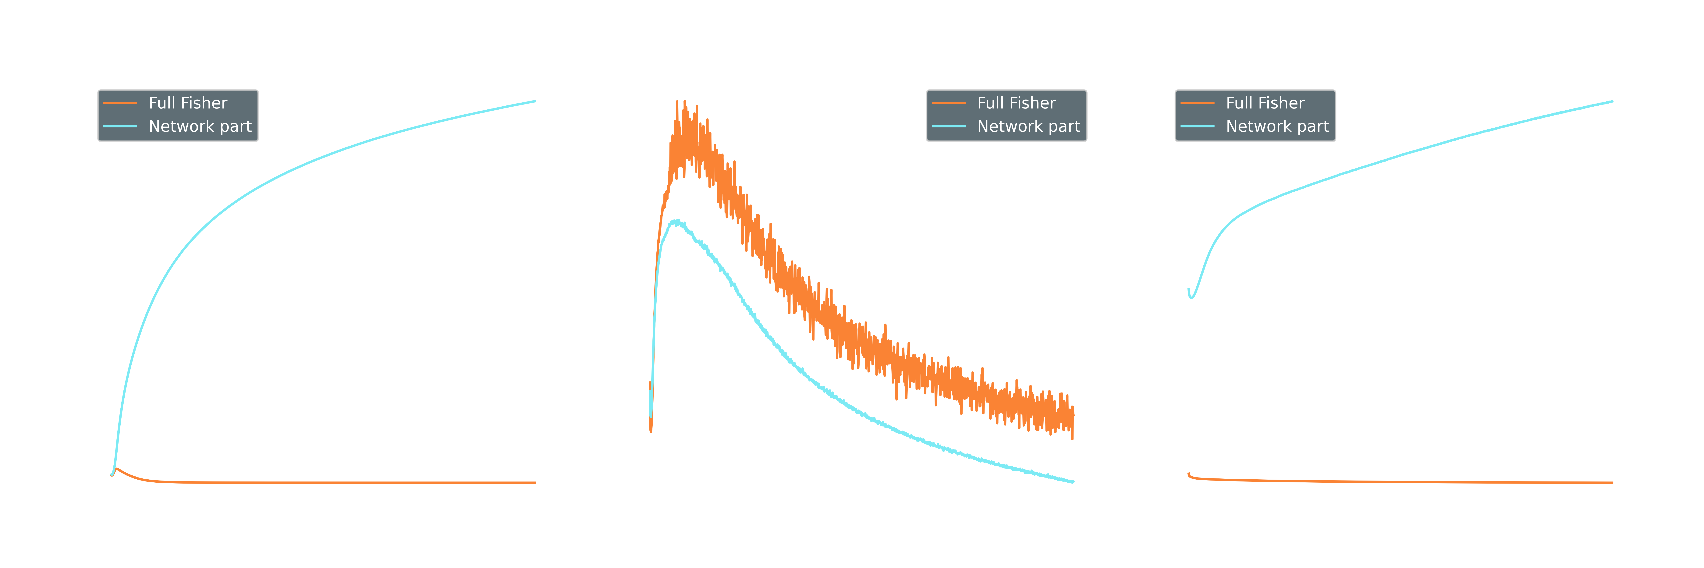
Experimental use

Slide 16
Experimental use

Slide 17
Experimental use

Slide 18
Experimental use

Slide 19
Experimental use

Slide 20
Experimental use

Slide 21
Experimental use

Slide 22
Experimental use

Slide 23
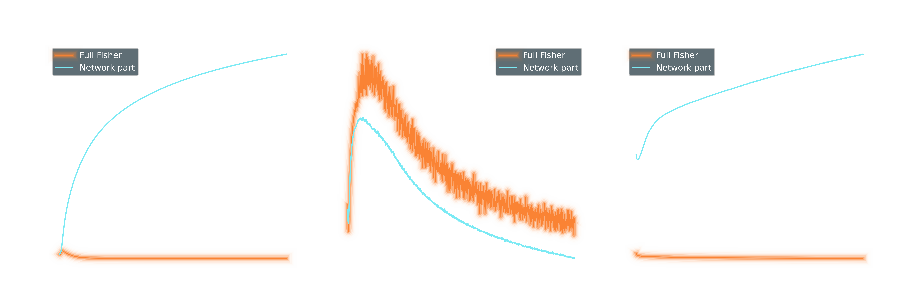
Experimental use

Slide 24
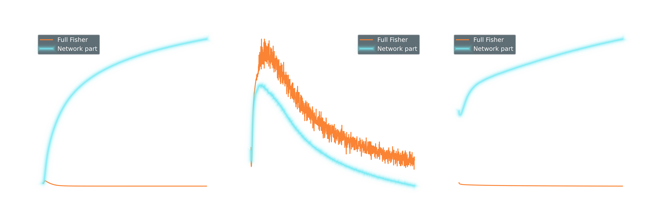
Experimental use

Slide 25
Experimental use

Slide 26
Experimental use

Slide 27
Experimental use

Slide 28
Experimental use

Slide 29
Experimental use

Slide 30
Experimental use
→ Loss function drives the Network to a high sensitivity state
→ Loss function drives the Network to a high sensitivity state

Slide 31
Experimental use
→ Loss function drives the Network to a high sensitivity state
→ Loss function only introduces a offset in the sensitivity
→ Loss function drives the Network to a high sensitivity state

Slide 32
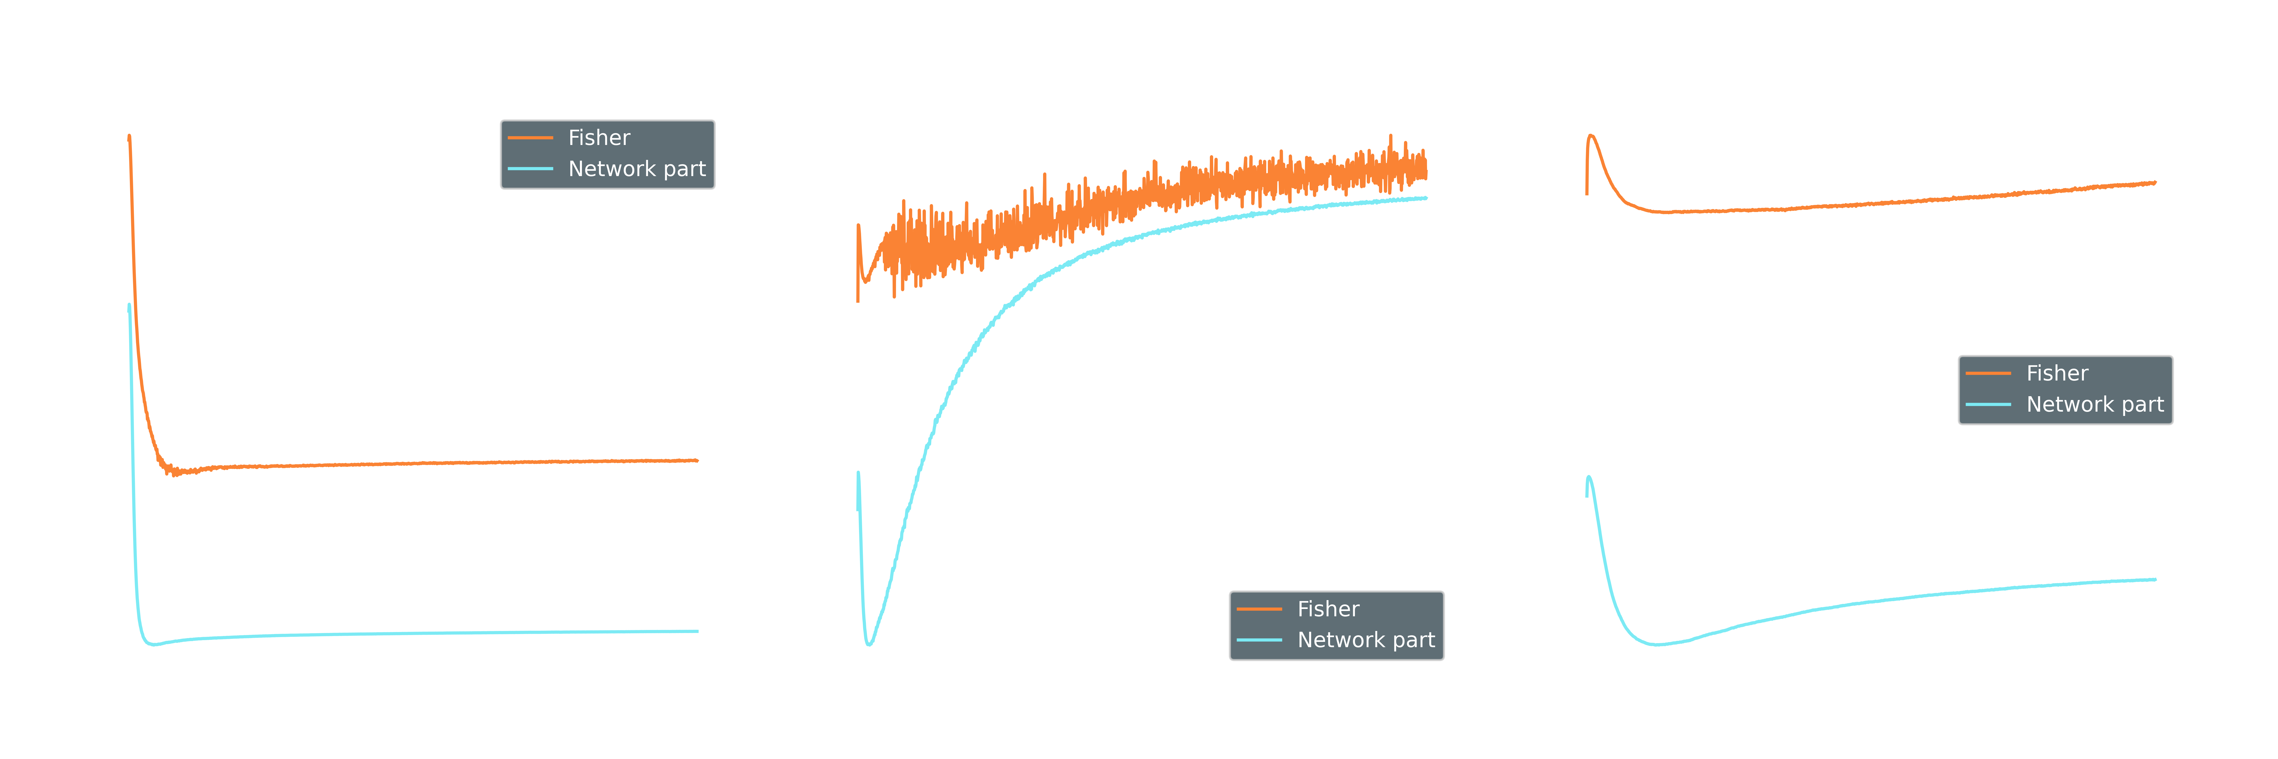
Experimental use

Slide 33
Experimental use

Slide 34
Experimental use

Slide 35
Experimental use

Slide 36
Experimental use

Slide 37
Experimental use
→ Loss function leads to a constant offset in entropy. It disregards correlations.
→ Loss function leads to a constant offset in entropy. It disregards correlations.

Slide 38
Experimental use
→ Loss function leads to a constant offset in entropy. It disregards correlations.
→ Loss function raises correlation in the network during training.
→ Loss function leads to a constant offset in entropy. It disregards correlations.

Slide 39
Summary and Outlook
By Investigating collective variables of Fisher

Slide 40



People
Sven Krippendorf
(LMU Munich)
Konstantin Nikolaou
(ICP Stuttgart)
Samuel Tovey
(ICP Stuttgart)
Christian Holm
(ICP Stuttgart)

